Slide 1

REVERSE PROXY
-Presented By KAVIN BABU

Slide 2

Outline
Client – Server Architecture
Reverse Proxy Introduction
Reverse Proxy Flow
Some Important Uses of Reverse Proxy
Forward Proxy Comparison
Forward Proxy uses
Implementation
Conclusion

Slide 3
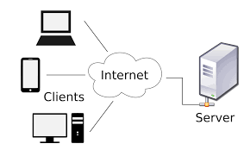
Client – Server Architecture
In a client-server architecture, communication is established between two entities: the client and the server.
Clients are end-user devices or applications that initiate requests for services, such as web browsers or mobile apps.
Servers are powerful machines or software applications that manage and provide requested services, storing data and handling processing tasks.

Slide 4
Reverse Proxy Introduction
A Reverse Proxy is a server that sits in front of Web servers and forward client(e.g, Web Browser) requests to those Web servers.
Reverse proxies are typically implemented to help increase security, Performance and reliability.

Slide 5
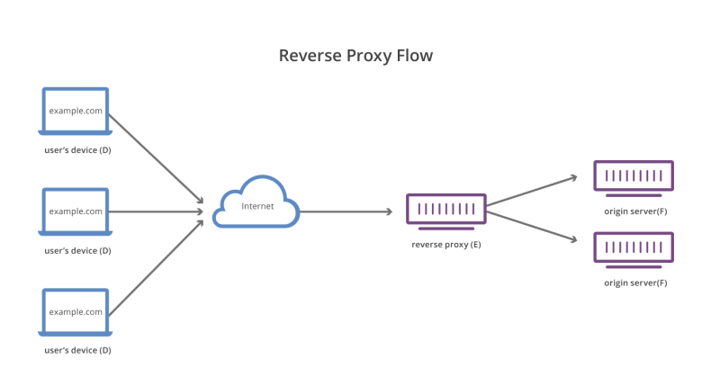
Reverse Proxy Flow
User’s Device sends request to Origin servers from the Internet, then a reverse proxy taking requests and forwarding them to origin servers.

Slide 6
Some Important uses of Reverse Proxy
Reverse Proxy will cache data for next usage.
Load Balancing : Balances multiple requests from different Clients.
Encryption and Decryption of the Requested Data.

Slide 7
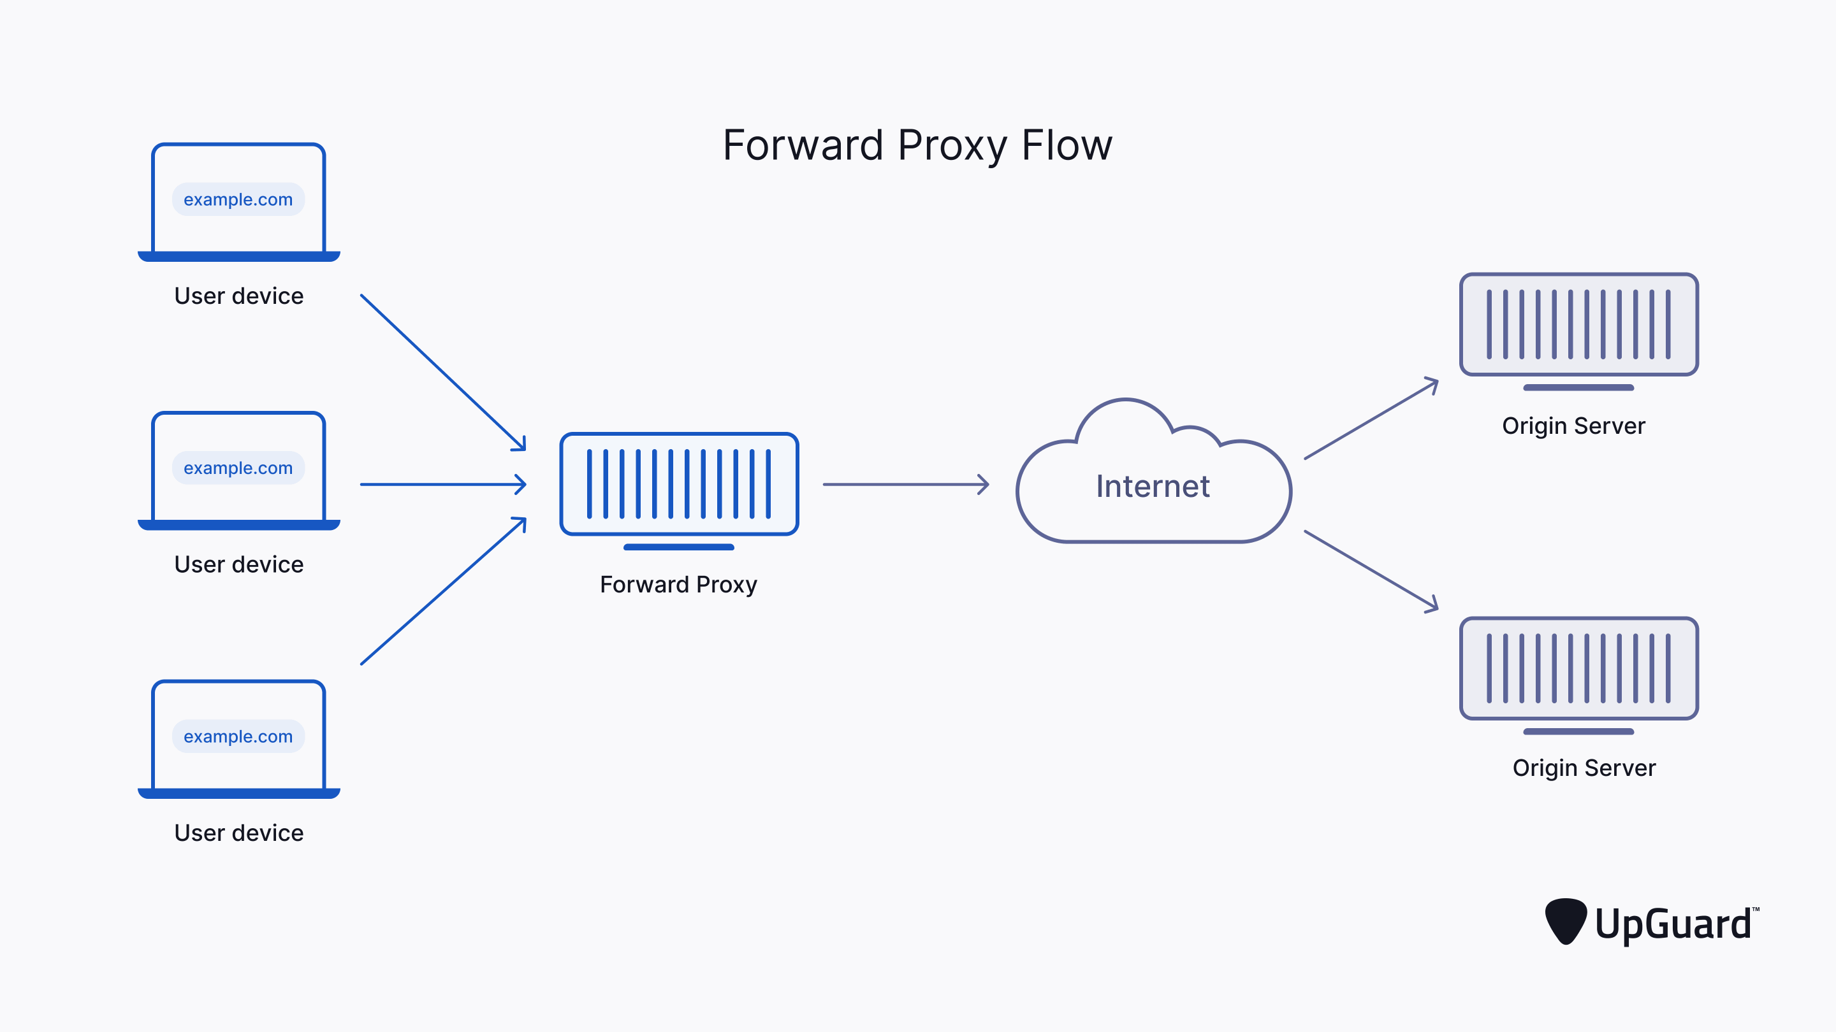
Forward Proxy Comparison
A forward Proxy is a server that acts on behalf of a client.
A client send requests to a forward proxy which is able to do something that client can’t do, then they forward send requests to the origin servers.

Slide 8
Forward Proxy Uses
Forward Proxy Protects Client’s Online identity.
Forward Proxy Bypasses the browsing Restrictions.
Forward proxy blocks access to certain contents.

Slide 9
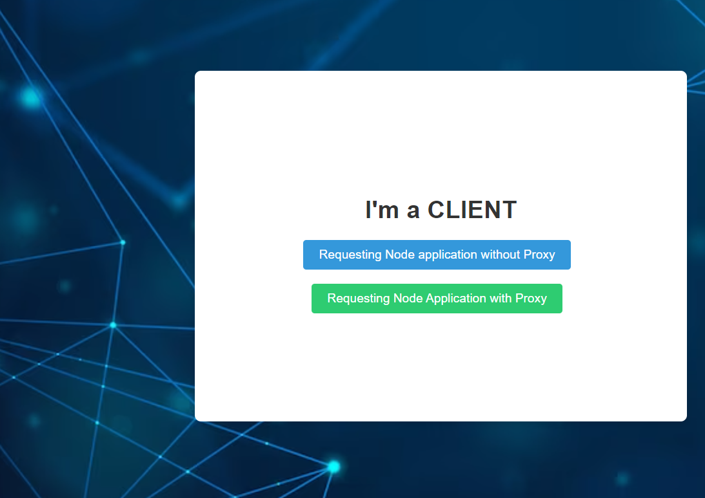
Client Webpage to send Requests

Slide 10
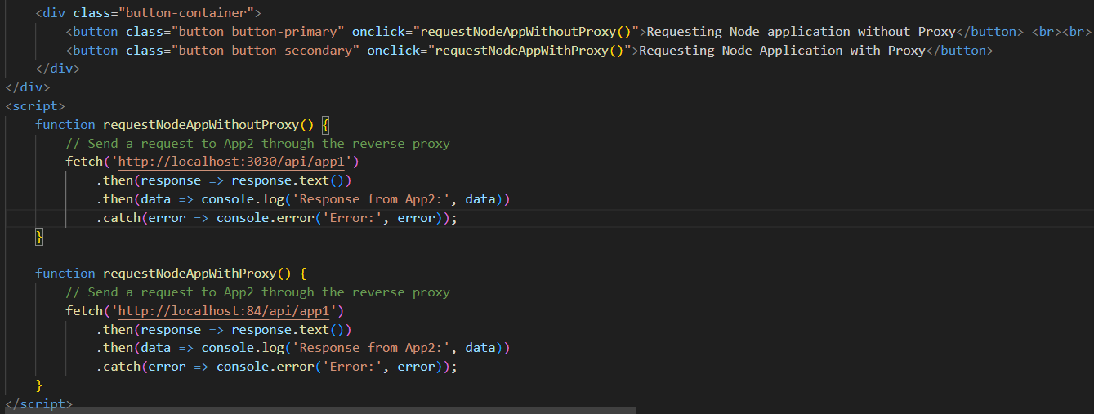
Client website

Slide 11
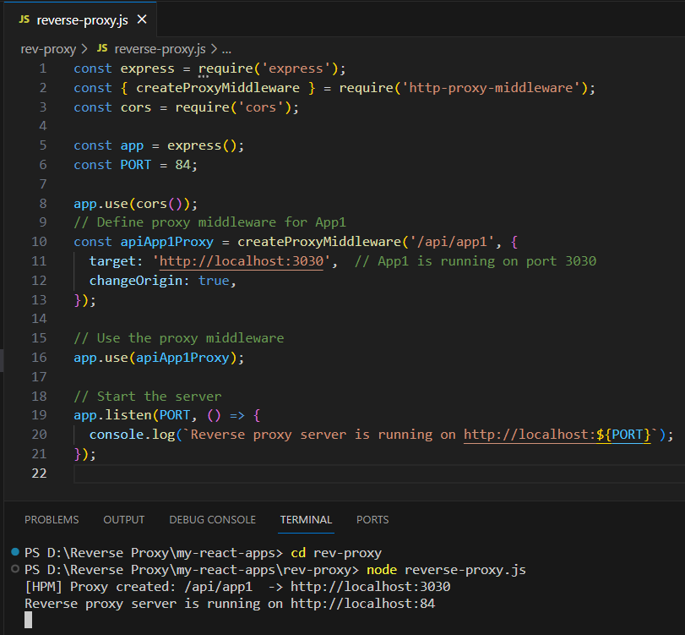
Activating reverse Proxy Server

Slide 12
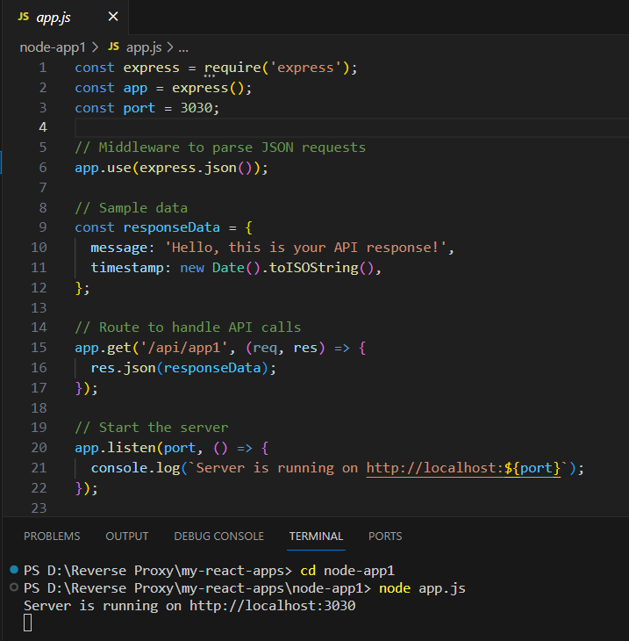
Node Application

Slide 13


